Slide 1

Mortgage Delinquency
Data Science Certificate Program: Cohort 16

Slide 2
Domain Information

Slide 3
Hypothesis

Slide 4
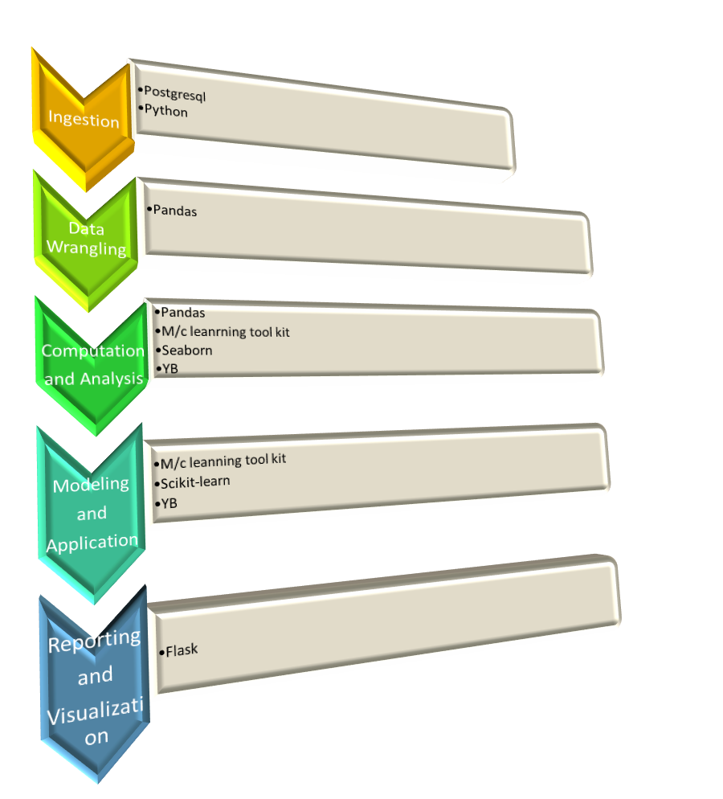
Pipeline Architecture

Slide 5
Breakdown of pipeline on slides

Slide 6
Data – set Exlporation

Slide 7
EDA – Results

Slide 8
Machine Learning – Yellow-brick Feature

Slide 9
Model Selection

Slide 10
Model Results

Slide 11
Conclusion

Slide 12
Further Exploration

